Slide 1

Customer Churn Analysis
Using Power Bi
By: Sripada Jain

Slide 2

Agenda
1.Business Problem
2. Objective
3. Dataset Overview
4. Analysis & Visualizations
5. Key Insights
6. Recommendations & Conclusion

Slide 3
Business Problem
Customer churn is a major concern for telecom companies.
The goal is to identify customers likely to leave and understand what drives churn.

Slide 4
Objective
To analyze customer data and discover key factors influencing churn, helping the company improve retention strategies.
The goal of this analysis is to understand the key factors :-
Influence customer churn.
The likelihood of customers leaving the company.
To develop strategies to improve retention.

Slide 5
Dataset Overview
Total Records: 7,043
Total Columns: 21
Target Variable: Churn (Yes/No)
Feature Categories
- Customer Info: gender, Senior Citizen, Partner, Dependents
- Account Info: tenure, Contract, Payment Method, Paperless Billing
- Services: Internet Service, Tech Support, Streaming TV, etc.
- Charges: Monthly Charges, Total Charges

Slide 6
Data Cleaning
Checked for null or missing values
Converted Total Charges to numeric
Encoded categorical variables
Standardized continuous variables

Slide 7
Analysis & Visualizations Dashboard's Structure
Customer Demographics Analysis :Understand overall churn summary & KPIs Study of churn across gender, age, and seniority.
Service Subscription Analysis: Identify churn by services and add-ons.
Contract & Billing Insights: Analyze churn based on payment and contract type.
Churn Prediction & Key Drivers: Find high-risk churn segments visually.

Slide 8
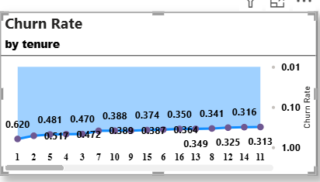
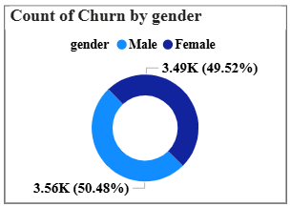
Customer Demographics Analysis
1.Churn Rate by Tenure
Visualization: Line Chart
Purpose: Shows how customer churn rate changes with the duration (tenure) of their relationship with the company.
Insight: Customers who stay beyond 12 months are more stable and less likely to churn
Business Action: Implement onboarding and retention offers during the first 6 months of customer engagement. Offer loyalty rewards for those who cross 1-year tenure.
2.Count of Churn by Gender
Visualization: Donut Chart
Male: 3.56K (50.48%)
Female: 3.49K (49.52%) Gender distribution is almost equal — churn isn’t influenced much by gender.

Slide 9
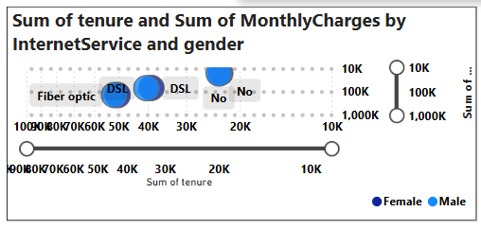
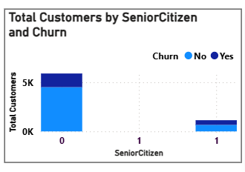
3.sum of tenure , montly charges by Internet Service and Gender
Visualization: Clustered Bar or Bubble Chart
Purpose: Shows which internet service category contributes most to churn.
Insight : Service quality or price dissatisfaction among Fiber optic users is driving churn.
Business Action:
Investigate service complaints or pricing dissatisfaction among Fiber optic customers.
Introduce value-added services or flexible pricing to retain these high-value customers.
4. Churn by Senior Citizen & Gender
Visualization: Clustered Column + Donut Chart Combo
Purpose: Analyze churn based on age group (SeniorCitizen) and gender demographics.
Insight: Senior citizens may face difficulties with digital services or may prefer prepaid/short contracts.
Business Action
Provide personalized support and simpler billing plans for senior customers.
Gender-focused campaigns are not necessary; focus on senior customer engagement instead.

Slide 10
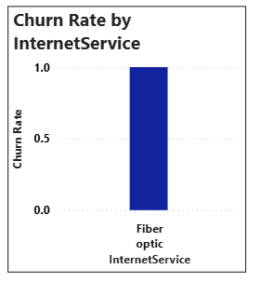
Service Subscription Analysis
1.Churn Rate by Internet Service
Visualization: Clustered column chart
Purpose: To pinpoint service-related dissatisfaction by assessing the churn risk associated with different internet technologies.
Insights:
Customers with Fiber optic internet are churning at a disproportionately high rate of $41.9\%$.
This rate is more than double that of DSL customers ($19.0\%$), strongly suggesting a major issue with the Fiber optic offering.
Business Action: Launch a dedicated task force to investigate the Fiber optic service offering, focusing on network reliability, reported outages, speed inconsistencies, and customer support for this high-risk segment.
2.Correlation between the number of subscribed services and the likelihood of churn
Purpose: To determine the relationship between the level of product bundling/stickiness and the likelihood of a customer leaving the service.
Insights: customers are paying a premium but not receiving enough offset core service dissatisfaction.
Business Action: Prioritize retention efforts on the 1 and 2 add Business Action:-on segments, as they represent the highest churn risk group.

Slide 11
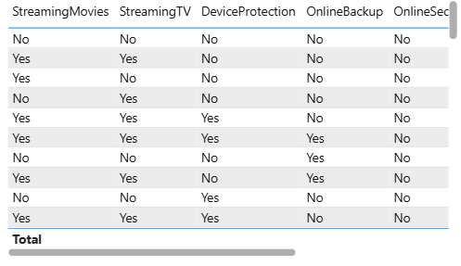
3. Add-on services by customers who churned
1. Streaming Services (Streaming Movies & Streaming TV)
Visualization : Table
Purpose: To identify which premium add-on services are failing to retain customers, signaling potential issues with pricing, content value, or service quality associated with those features.
Insights: Streaming Movies ($43.77\%$) and Streaming TV ($43.55\%$) are the most commonly used add-ons by customers who churned. This indicates that a high proportion of customers leaving the company were paying for and using these entertainment services.
Business Action: Review the pricing and content strategy for streaming packages. Consider bundling them more creatively with long-term contracts or core services, or ensure the quality (buffering, content library) is competitive, as customers are willing to pay but are still leaving.
2. Protective/Support Services (Online Security & Tech Support)
Purpose: To assess the retention power of services specifically designed to reduce customer pain points and increase security.
Insights: Online Security ($15.78\%$) and Tech Support ($16.59\%$) are the least used add-ons by churned customers.
Business Action: Use these findings to fuel an aggressive cross-sell campaign. Position Online Security and Tech Support as essential retention tools that actively prevent customers from leaving. Offer strong incentives to high-risk customers.

Slide 12
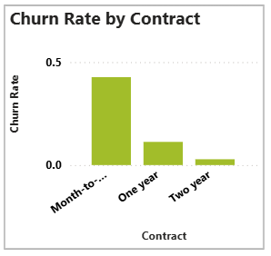
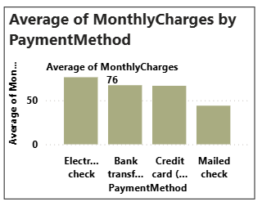
Contract & Billing Insights
1.Contract Type vs. Churn Rate
Visualization: A Column Chart
Purpose: To identify which contract length exposes the business to the highest churn risk and how contract term length influences customer loyalty.
Insights: The Month-to-month contract segment is the primary source of churn, with a striking rate of $42.7\%$. This rate is dramatically higher than the highly stable Two-year contract rate of just $2.85\%$.
Business Action: Immediately launch loyalty programs and targeted offers for Month-to-month customers to incentivize them to sign a 12- or 24-month contract, effectively locking in stability.
2.Average of Monthly Charges by Payment Method
Visualization: Bar chart
Purpose: To compare the average monthly charges paid by customers across different payment methods.
Insight: Customers who use Electronic Check have the highest average monthly charges. The charges for Bank Transfer (Automatic) and Credit card (Automatic) are slightly lower but similar to each other. Customers who use Mailed Check have the lowest average monthly charges.
Business Action: Investigate and Upsell, Target Mailed Check Users, Prioritize High-Value Experience

Slide 13
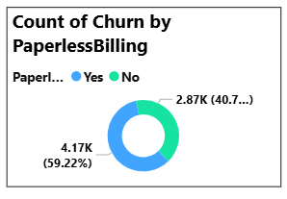
3.Count of Churn by Paperless Billing
Visualization: Donut chart
Purpose: To show the distribution of churned customers based on whether they had Paperless Billing ("Yes" or "No").
Insight: A significantly higher proportion of churned customers had Paperless Billing. Specifically, $4.17$K (or $59.22\%$) of the churned customers had Paperless Billing, while $2.87$K (or $40.7\%$) of the churned customers did not.
Business Action: Investigate the Paperless Billing process and customer experience.
Action 1: Survey or conduct focus groups with customers who recently churned and were on Paperless Billing to understand if there were any frustrations or issues related to receiving, accessing, or managing their bills.

Slide 14
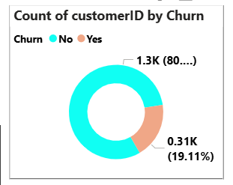
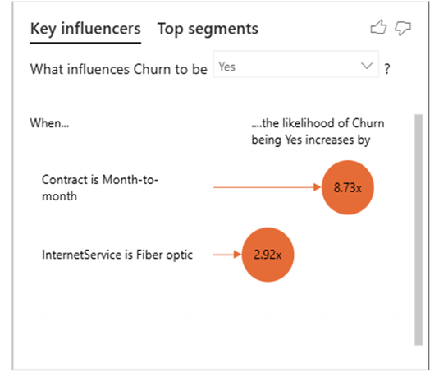
Churn Prediction & Key Driver
1.Count of customer ID by Churn
Visualization: Donut chart
Purpose: To display the overall proportion of customers who have churned ("Yes") versus those who have not ("No") within the analyzed dataset.
Insight: The majority of customers have not churned ("No"). of the customers have churned. The overall churn rate is approximately $19.11\%$. while $0.31$K
Business Action: Retention Develop proactive retention strategies for the $80.89\%$ of current customers to ensure they remain satisfied and don't contribute to future churn.
2. Factors have the strongest influence on customer churn
Visualization: "Key influencers" analysis chart
Purpose: To identify the key factors (customer attributes or services) that most significantly increase the likelihood of a customer churning.
Insight:
Contract Type is the Dominant Factor: The single most influential factor increasing the likelihood of churn is the customer having a Month-to-month contract.
Service Type is a Secondary Factor: Having Fiber optic Internet Service is the second-most influential factor, increasing the likelihood of churn by $2.92$ times.
Business Action: Prioritize switching customers from short-term to long-term contracts and investigate the fiber optic service experience.

Slide 15
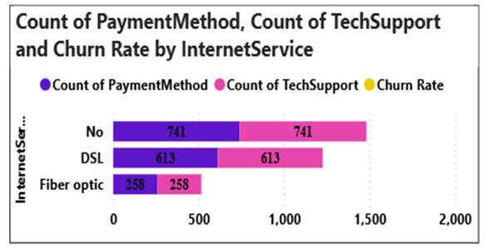
3.Count of Payment Method , Count of Tech Support and Churn Rate by Internet Service
Visualization: Stacked bar chart
Purpose: To compare the number of customers across different Internet Service types based on the counts of "Payment Method" and "Tech Support" entries.
Insight (Based on Counts):
The visualization shows the distribution of customers across the three Internet Service categories:
No Internet Service (No): Highest count of {741}$ customers.
DSL: Moderate count of {613}$ customers.
Fiber Optic: Lowest count of {258}$ customers.
Business Action: Confirm the actual Churn Rate for each service, as this critical data point is missing from the visualization but is necessary to prioritize retention efforts. Target the No Internet Service segment and Focus on Fiber Optic Growth/Fix.

Slide 16
Key Insights
High Overall Churn Rate (27%)
More than 1 out of 4 customers have discontinued the service, showing a need for stronger retention efforts.
Short- Term Customers Are Most Likely to Churn
Churn rate is highest during the first 6 months of customer tenure, suggesting weak initial engagement
Contract Type Strongly Affects Retention
Month-to-month users show the highest churn, while annual and two-year contracts significantly reduce churn.
Senior Citizens Show Higher Churn
Older customers are leaving at higher rates, possibly due to service complexity, pricing, or lack of tech support.
Internet Service Impacts Churn
Fiber optic customers churn more likely due to higher costs or service dissatisfaction, while DSL users show moderate stability.
Gender Has Minimal Effect on Churn
Male and female customers have nearly equal churn rates, meaning gender is not a key predictor.

Slide 17
Recommendations & Conclusion
Improve Early-Stage Retention
Focus on the first 3–6 months by introducing welcome offers, personalized onboarding, and follow-up calls.
Promote Long-Term Contracts
Encourage month-to-month customers to upgrade to yearly or multi-year plans with discounts or bundled packages.
Target Senior Citizens with Simpler Plans
Create easy-to-understand plans, provide 24/7 customer support, and offer senior-friendly digital assistance.
Address Fiber Optic Service Issues
Review pricing and service quality for fiber customers. Conduct feedback surveys to identify improvement areas.
Reward Loyalty
Implement loyalty programs or cashback offers for customers with longer tenure to strengthen satisfaction and retention.

Slide 18
Conclusion
Customer churn is primarily driven by short-term contracts, low tenure, and service dissatisfaction rather than gender.
By focusing on early engagement, contract retention, and personalized customer care, the company can significantly reduce churn and improve customer lifetime value.

Slide 19


